Slide 1
AN EXPERIMENTAL STUDY OF BEHAVIOUR OF CONCRETE MADE USING COPPER SLAG AS FINE AGGREGATE
Under esteemed Guidance of
Mr.M.Jeilani, M.Tech
Area of specialization: Rs&Gis
Designation:Assistant Professor
PRESENTED BY
E.SOWMYA
ROLL.NO-15TK1D2004

Slide 2
INTRODUCTION
concrete are being widely used in the construction activities. When compared to western countries, the usage of steel is far less is our country .concrete also has the advantage of easy handling and proficiency in design not expected as in the case of steel.
Nowadays due to the boom in the infrastructure development, the volume of concrete being used in the construction has rise to a large level. Recently, composites have been fast replacing conventional materials in concrete. Newer materials are used in the concrete, so that deficient properties of concrete can be enhanced to our convenience of making concrete a versatile material. Some of the composite materials are fibers, slag, fly-ash etc.
With many major developments in the concrete industry, the waste materials utilization in the manufacturing of concrete being used as ingredients of replacement or reused materials.
In the past few decades, due to the globalization being extensively propagated, the growth of industries in our country has increased. As the industries are growing consequently with their production wastage which leads to increased in many folds. These kinds of wastage products are from some of the industries which may leads to environmental hazards, if it is not disposed appropriately. As the construction activities increase, the use of concrete is also gaining demand.

Slide 3
Copper slag
Copper slag is a by-product of copper production from copper ores contains materials like iron,alumina,calcium oxide,silica
For every tonne of metal production about 2.2 to 3.0 tonne of slag is generated and in each year approximately 24.6million tone of slag is generated from world copper production
Dumping or slag cause environmental and space problems
During the past two decades attempts have been made by several investigators and copper producing units all over the world to explore the possible utilization of copper slag

Slide 4
USES OF COPPER SLAG INSIDE CONCRETE
American concrete institute (Moura et al., 1999) used the copper slag from Bahia, Brazil as construction materials. They observed that the characteristic of the material was equivalent to the traditional ones or even better. So copper slag can be a potential alternative to the admixtures used in concrete and mortars.
Use of slag from copper refining as entrancing mix in solid drift towords updating in to made by utilizing strategy for making use of technique for akihiko and takashi (1996)
Copper slag was used as fine aggregate for concrete by Toshiki et al.(2000). They described the strength, setting time and durability of concrete with copper slag.

Slide 5
ADVANTAGES OF COPPER SLAG
Cement raw material ( iron supplementation )
Sand blasting ( rust scouring of iron surfaces )
Caisson ( filling material )
Portland cement replacement in concrete
Good use for sand replacement in concrete
Increase compressive strength of concrete
Refinement of porosity
Improvement of durability
Copper slag prevented the environment being polluted
Cost is very less

Slide 6
OBJECTIVE OF THIS PROJECT:
Total of six batches of concrete mixes required by the scope of the project. For each concrete mix batch will increments of 20% on aggregate replacement from 0% to 100%.
The investigation and laboratory of testing on reused of aggregate concrete specimens such as split tensile test, compression test and flexural test for 7 and 28 days.

Slide 7
MATERIALS USED
Cement - Ordinary Portland Cement with 53 Grade.
Copper slag - Slag passing through 4.75mm seive.
Water - Ordinary portable water.
Fine Aggregate - Natural river sand.
Coarse Aggregate - Aggregate passing through 20mm sieve.

Slide 8
cement
cement is a binder, a substance which sets and hardens independently, and can bind other materials together. The volcanic ash and pulverised brick additives which were added to the burnt lime to obtain a hydraulic binder were later referred to as cemented, and cement.
The most commonly used type of cement is Ordinary Portland Cement

Slide 9
Composition of Ordinary Cement
Lime (CaO) 62%
Silica (SiO₂) 22%
Alumina (Al₂O₃) 5%
Calcium Sulphate (CaSO₄) 4%
Iron Oxide (Fe₂O₃) 3%
Magnesium (MgO) 2%

Slide 10
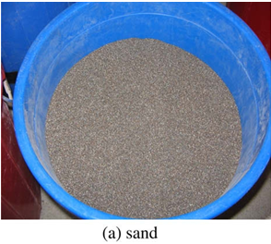
FINE AGGREGATE
Aggregate of size is less than 4.75mm are usually called as fine aggregate. It is the natural material that fills voids in between the course aggregate.
To produce workability and uniformity for concrete.
To assist the cement paste to hold the particles of coarse aggregate suspension and to prevent paste to hold to the possibility of segregation.

Slide 11
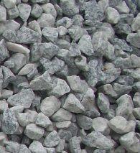
COURSE AGGREGATE
The size of aggregate bigger than 4.75 mm is considered as coarse aggregate crushed stone obtained by crushing of granite that could pass through 20mm sieve and retained on 10mm zIS sieve and contained only so much of five materials as is permitted by specification along were procured
It should be had strong, dense durable, rough and free from salt and organic matters. Well graded aggregate provided denser concrete with less voids.

Slide 12
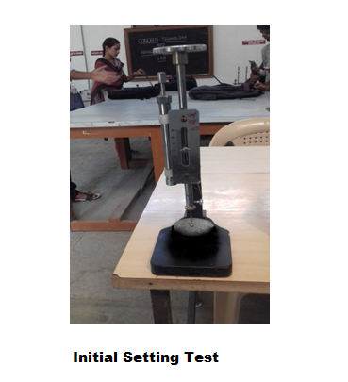
INITIAL SETTING TIME
Prepare a neat 300grams of Cement paste by gauging the cement with 0.85times the water required to give a paste of standard consistency. Portable or distilled water shall be used in preparing the paste.

Slide 13
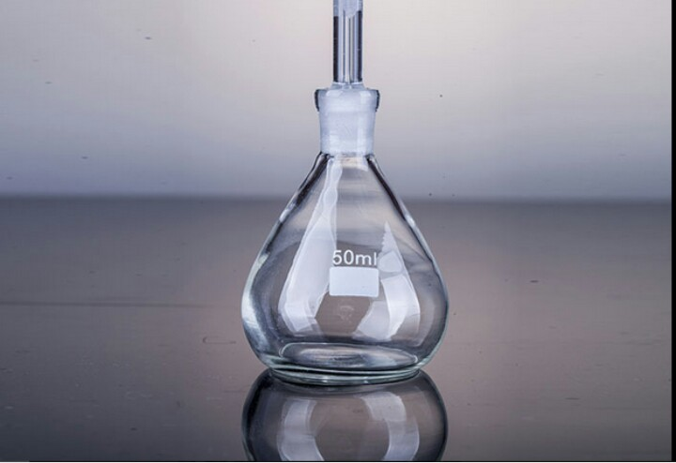
SPECIFIC GRAVITY
Pycnometer (W₁) = 0.670kg
Pycnometer + cement (W₂) = 0.954kg
Pycnometer + cement + kerosene (W₃) = 1.524kg
Pycnometer + kerosene (W₄) =1.33kg
Specific gravity of cement = 3.15

Slide 14
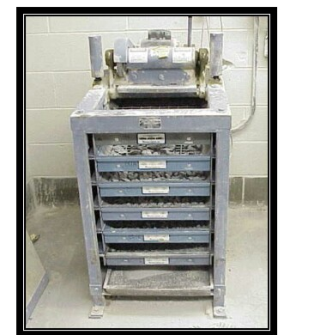
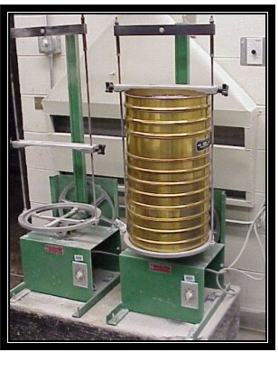
Tests For Fine Aggregate and coarce aggregate

Slide 15
Sieve Designation | Weight Of Residue | % Of Weight Retained | Cumulative % of weight Retained | % Of Passing
4.75 | 0.024 | 2.4 | 2.4 | 97.6
2.36 | 0.052 | 5.2 | 7.6 | 97.2
1.18 | 0.105 | 10.5 | 18.1 | 92.3
600 | 0.184 | 18.4 | 36.5 | 89.3
425 | 0.281 | 28.1 | 64.5 | 82.6
300 | 0.077 | 7.7 | 72.3 | 90.3
150 90 75 | 0.294 0.028 0.013 | 24.9 2.8 1.3 | 97.2 100 101.3 | 84.8 87.6 88.9

Slide 16
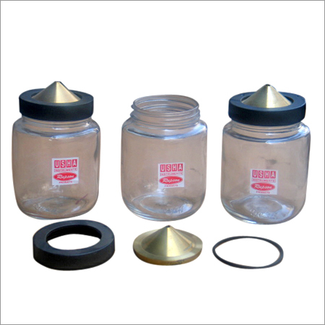
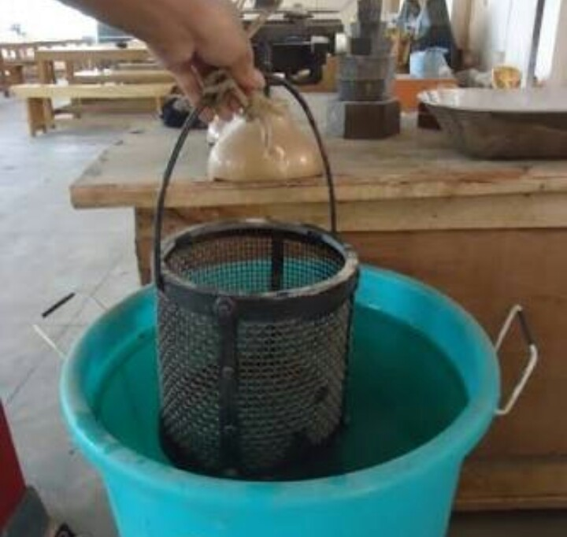
SPECIFIC GRAVITY

Slide 17
Specific gravity of fine aggregate = 2.45
Specific gravity of coarse aggregate = 2.7
Specific gravity of copper slag = 3.75

Slide 18
PREPARATION OF SPECIMENS
Proportioning
The proportions of the materials, including water, in concrete mixes used for determining the suitability of the materials available
2. Weighing
he quantities of cement, each size of aggregate, and water for each batch shall be determined by weight, to an accuracy of 0.1 percent of the total weight of the batch.

Slide 19
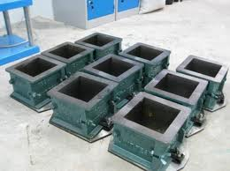
Cube Moulds
The mould shall be of 150mm size conforming to IS: 10086-1982.

Slide 20
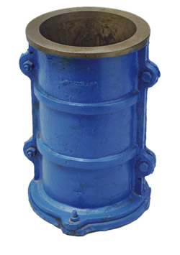
Cylinders:
The cylindrical mould shall be of 150mm diameter and 300mm height conforming to IS: 10086-1982.

Slide 21
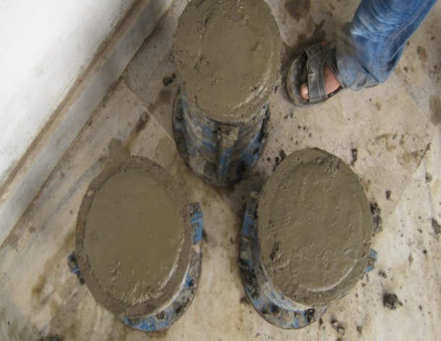
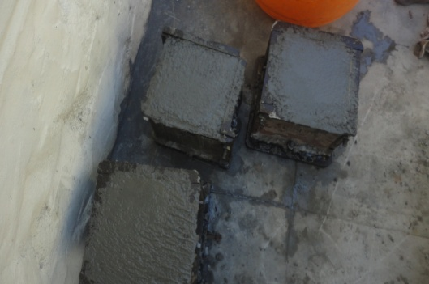
Compacting:

Slide 22
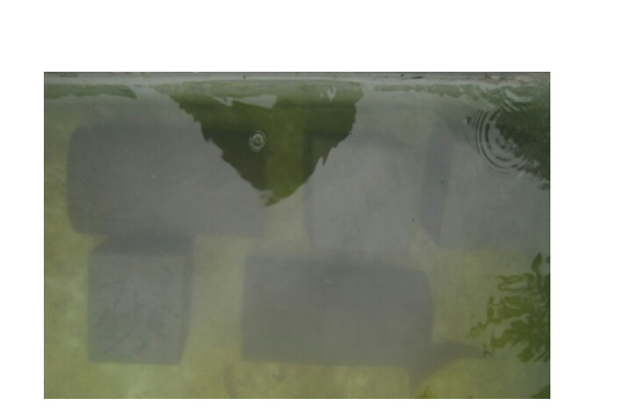
Curing:

Slide 23
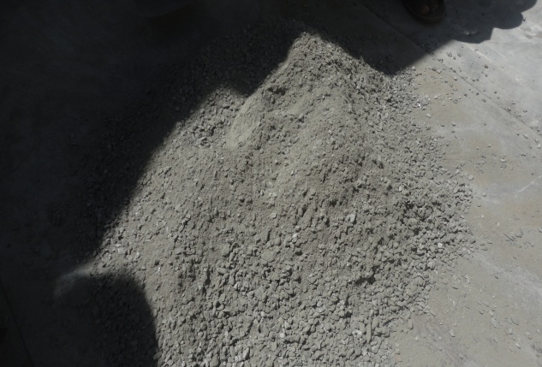
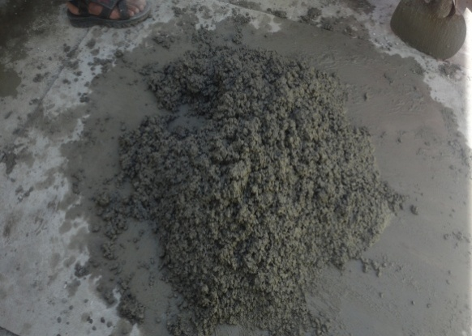
MIXING MIXTURE

Slide 24
DESIGN OF M20 GRADE CONCRETE
Step: 1
Fck’ = fck + t.s
Step: 2
Selection of W/C Ratio
Targeted Mean strength (fck^{’)} 26.6N/mm²
W/C Ratio 0.53
Estimation of Air content
Nominal maximum size of aggregate 20mm
Entrapped Air 2.0

Slide 25
Selection of sand & water content
Nominal Maximum size of aggregate 20mm
Water content 186kg
Sand 35%
Step: 5
Determination of fine aggregate (Sand)
V = [W +(C/S_{C}) + (fa/Sfa) (1/P)] X (1/1000)
Determination of fine aggregate (Copper Slag)
V = [W +(C/S_{C}) + (fa/Sfa) (1/P)] X (1/1000)

Slide 26
Determination of coarse aggregate
V = [W +(C/S_{C}) + (ca/Sca) (1/1-P)] X (1/1000)
Mix proportion of M₂₀
Cement (Kg/m³) | F.A (Kg/m³) | C.A (Kg/m³) | Water content (Kg/m³)
350 | 585.66 | 1200.15 | 186
1 | 1.65 | 3.42 | 0.53

Slide 27
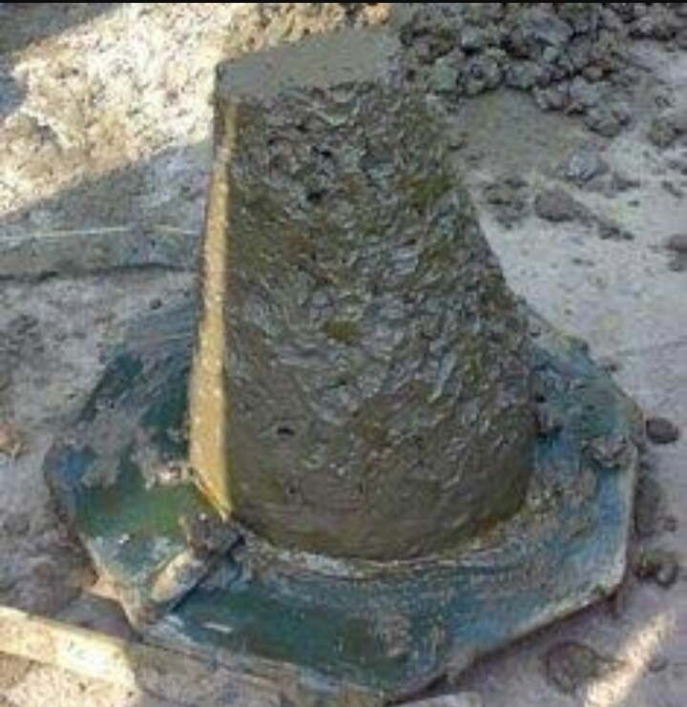
SLUMP TEST

Slide 28
Slump Test on Fresh Concrete
SL.NO | Percentage of Copper Slag (%) | Slump (mm)
1 | 0% | 29
2 | 10% | 28
3 | 20% | 26
4 | 30% | 23
5 | 40% | 23
6 | 50% | 24
7 | 60% | 24
8 | 70% | 22
9 | 80% | 21
10 | 90% | 21
11 | 100% | 20

Slide 30
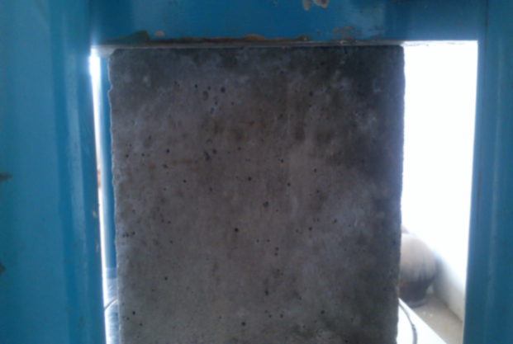
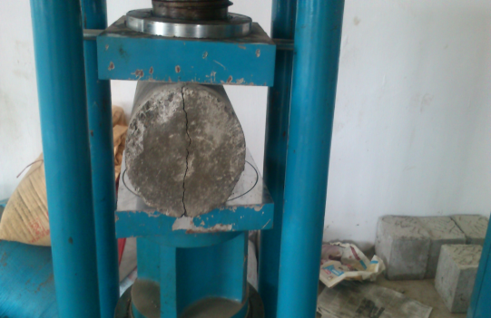
COMPRESSION TEST

Slide 31
Compressive Strength on Concrete Cubes at 7 Days
Sl noc | Percentage Of Replaced copper slag as fine Aggregate (%) | Compressive Strength N/mm²
1 | 0 | 19.68 | 20.172 | 19.03 | 19.627
2 | 10 | 20.928 | 21.826 | 19.86 | 20.871
3 | 20 | 21.752 | 22.831 | 21.473 | 22.018
4 | 30 | 23.74 | 22.58 | 22.32 | 22.88
5 | 40 | 23.923 | 23.766 | 23.853 | 23.847
6 | 50 | 24.466 | 22.873 | 23.568 | 23.655
7 | 60 | 22.133 | 24.156 | 23.586 | 23.291
8 | 70 | 22.91 | 22.86 | 21.92 | 23.563
9 | 80 | 21.53 | 20.985 | 21.986 | 21.50
10 | 90 | 21.12 | 20.03 | 21.85 | 21
11 | 100 | 19.32 | 19.58 | 19.83 | 19.57

Slide 32
Compressive Strength on Concrete Cubes at 7 Days

Slide 33
Compressive Strength on Concrete Cubes at 28 Days
SL.NO | Percentage Of Replaced copper slag as fine Aggregate (%) | Compressive Strength N/mm²
1 | 0 | 28.725 | 29.52 | 30.82 | 29.688
2 | 10 | 30.24 | 31.38 | 32.08 | 31.233
3 | 20 | 31.728 | 32.68 | 32.98 | 32.462
4 | 30 | 33.82 | 34.52 | 35.03 | 34.456
5 | 40 | 34.58 | 35.83 | 36.85 | 35.753
6 | 50 | 35.74 | 34.78 | 36.92 | 35.806
7 | 60 | 34.725 | 33.48 | 35.83 | 34.678
8 | 70 | 33.528 | 31.92 | 32.95 | 32.799
9 | 80 | 30.725 | 32.031 | 31.12 | 31.292
10 | 90 | 31.112 | 30.18 | 29.92 | 30.404
11 | 100 | 29.11 | 29.128 | 28.825 | 29.021

Slide 34
Compressive Strength on Concrete Cubes at 28 Days

Slide 35
Comparison of 7 And 28 Days

Slide 36
Split Tensile Test
SL.NO | Percentage Of Replaced copper slag as fine Aggregate (%) | Split Tensile Strength N/mm²
1 | 0 | 3.632 | 3.82 | 3.728 | 3.726
2 | 10 | 3.78 | 3.88 | 3.97 | 3.876
3 | 20 | 3.981 | 4.08 | 4.18 | 4.080
4 | 30 | 4.125 | 4.192 | 4.15 | 4.155
5 | 40 | 4.56 | 4.328 | 4.218 | 4.368
6 | 50 | 4.328 | 4.162 | 4.26 | 4.25
7 | 60 | 4.185 | 4.210 | 4.196 | 4.197
8 | 70 | 3.86 | 3.982 | 3.965 | 3.93
9 | 80 | 3.728 | 3.835 | 3.815 | 3.792
10 | 90 | 3.725 | 3.631 | 3.68 | 3.678
11 | 100 | 3.615 | 3.52 | 3.483 | 3.539

Slide 37
CONCLUSION
study has The investigated mechanical behaviors of concrete with sand replaced by different percentages of copper slag, including quasi-static and dynamic compression test and tensile splitting strength test. It is found that the smooth glassy surface texture and low moisture absorption, the excellent compressibility of copper slag can improve the workability and dynamic behavior of the concrete respectively, but the presence of excess water, the higher ﬁneness and ferric oxide content decrease the quasi-static compressive, ﬂexural and tensile splitting strength.
It is recommended that less than 40% copper slag as sand substitution can achieve a high strength concrete that comparable or better than the control mix, beyond which more voids, micro cracks and capillary channels appear in the microstructure of the concrete resulting in the concrete damaged at a premature strength level.
It also suggests that the determination of the copper slag replacement level should consider with the desired compressive strength of concrete.

Slide 38
THANK YOU….!

